Slide 1
EE451: High Voltage Engineering
Lecture 11

Slide 2
Outline
Breakdown Mechanism in Gases
Paschen’s Law
Penning Effect
Process of De-ionization
Page 2

Slide 3

Paschen’s Law
Townsend’s criterion for the breakdown of gases ɣ (e^{αd} – 1) = 1, does not relate this relate breakdown condition to the applied field stress U_{b}.
This implies that if Townsend’s experiment is performed at different electrode separations and gas pressures inside the chamber, different values of breakdown voltages will be obtained.
Paschen’s law states that breakdown voltage of a gap is a function (generally not linear) of the product of gas pressure p and gap length d.
Paschen’s law has been experimentally established for many gases, and it is a very important law in high voltage engineering.
Page 3

Slide 4

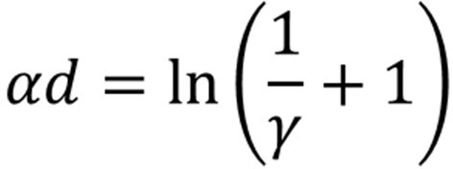
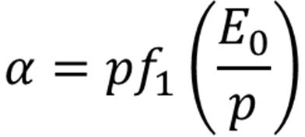
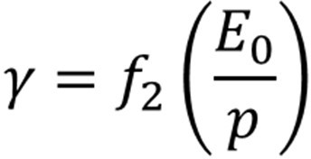
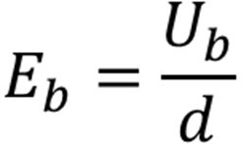
Paschen’s Law
Townsend’s criterion is:
where the coefﬁcients α and ɣ are functions of E₀/p and are given as follows,
where E₀ is the applied electric field and p is the gas pressure.
In a uniform field electrode system of gap distance d,
where U_{b} is the breakdown voltage and E_{b} the corresponding field intensity and is equal to the electric strength of the dielectric under given conditions.
Page 4

Slide 5
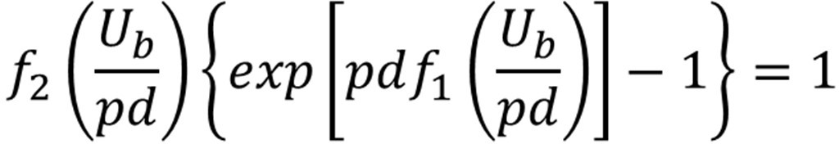

Paschen’s Law
When the applied field intensity E₀ = E_{b}, Townsend’s criterion for breakdown in electropositive gases in uniform field can be represented in terms of the product of the gas pressure and the electrode gap separation “pd” as,
This equation shows a relationship between U_{b} and pd, and implies that the breakdown voltage varies as the product pd varies.
Knowing the nature of functions f₁ and f₂, we can write,
This equation is known as Paschen's law.
Page 5

Slide 6
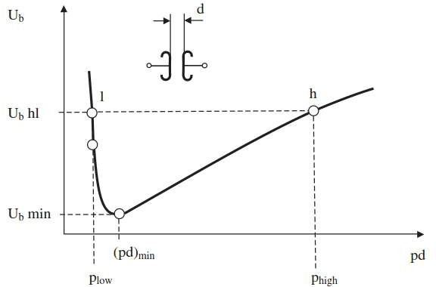
Paschen’s Law
Page 6

Slide 7
Paschen’s Law
The existence of a minimum sparking potential in Paschen's curve may be explained as follows:
For values of (pd) > (pd)_{min}, electrons crossing the gap make more frequent collision with the gas molecules than at (pd)_{min}, but the energy gained between the successive collision is lower than at (pd). Hence, the probability of ionization is lower unless the voltage is increased.
For values of (pd) < (pd)_{min}, the electrons cross the gap without making any collision or less number of collisions. Hence, more voltage has to be applied for breakdown to occur.
The point (pd)_{min}, therefore, corresponds to the highest ionization efficiency and hence, minimum sparking potential.
Page 7

Slide 8
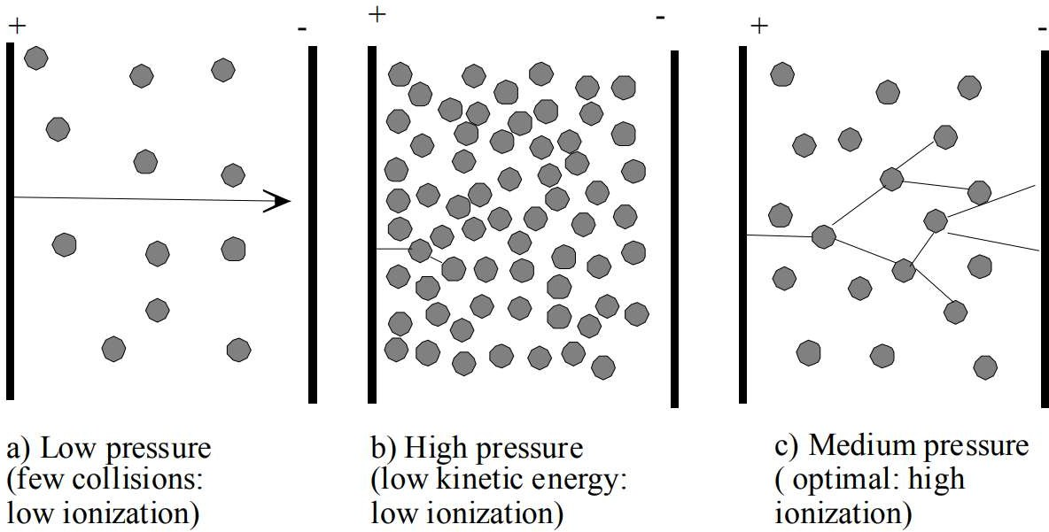
Paschen’s Law
Page 8

Slide 9
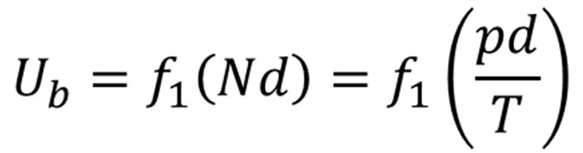
Paschen’s Law
A gas can be used as a good insulator if the (pd) value is kept very high [towards the right of (pd)_{min}] or very low [towards the left of (pd)_{min}].
Air and sulphur hexafluoride (SF₆) at high pressure are used in some high voltage equipment whereas vacuum circuit breakers use air at a very low pressure.
In order to account for the effect of temperature, Paschen’s law is generally stated as
U_{b} = f (Nd), where N is the density of the gas molecules.
This is necessary, because the pressure of the gas changes with temperature according to the gas law pv = NRT, where v is the volume of the gas, T is the temperature, and R is a constant.
Thus, Paschen’s law can be modified as follows:
Page 9

Slide 10
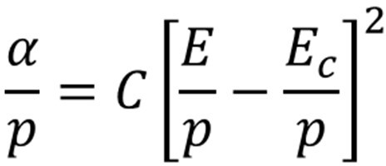

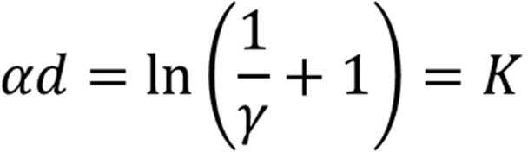
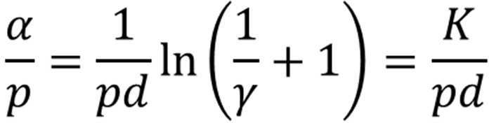
Paschen’s Law
According to Schumann, the ratio α/p may be expressed as:
(1)
where E and E_{c} are field intensities, E_{c} being the limiting value of E at which an effective impact ionization begins; p is the pressure and C a constant.
The breakdown criterion is given by,
Dividing both sides by pd,
(2)
Where K is constant
Page 10

Slide 11
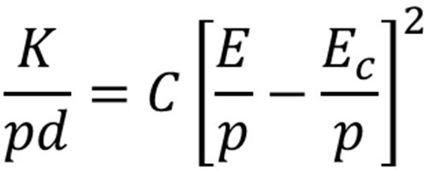
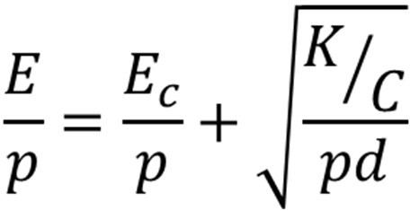
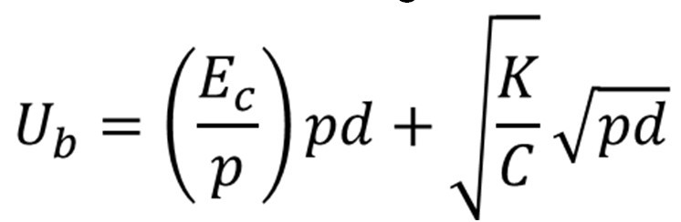
Paschen’s Law
Combining (1) and (2),
Thus, the expression for breakdown voltage in uniform fields is given by,
Under normal temperature and pressure conditions, at p = 1 bar and temperature 20º C, the values of the constants were determined as E_{c} = 24.36 kV/cm and K/C = 45.16 (kV)²/cm.bar

Slide 12
Paschen’s Law
Substituting these values,
(3)
where p is given in bar and d in cm, therefore pd in bar.cm.
For uniform electric field in air, the calculated values of breakdown voltages were compared with the experimental results. The calculated and the measured results agree with each other.

Slide 13
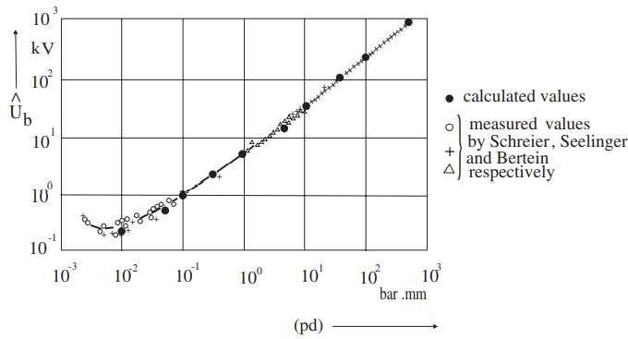
Paschen’s Law
Paschen’s curve for air in uniform field at temperature 20º C

Slide 14
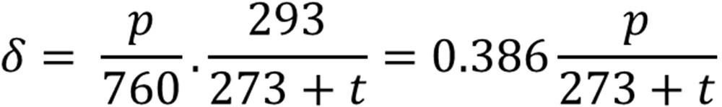
Paschen’s Law
It is more convenient to introduce the “relative gas density”, δ, a dimensionless quantity, in place of gas pressure p.
The relative gas density takes care of the effect of temperature on the mean free path of electrons in the gas at constant pressure.
The number of collisions made by an electron in crossing a gap is, therefore, proportional to the product δd and γ.
Correction for the variation in ambient conditions of air can be made by introducing the factor of “relative air density”, δ, defined as,
where p is in Torr and t in ºC

Slide 15

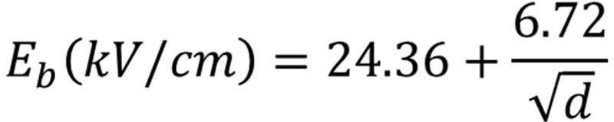
Paschen’s Law
At normal temperature (t = 20 ºC) and pressure (p = 760 Torr), δ is equal to one. By introducing δ in place of p in equation (3), this equation can be rewritten for normal temperature and pressure as,
It is interesting to note that even in uniform field at constant pressure and temperature, the electric strength of air is not constant.

Slide 16
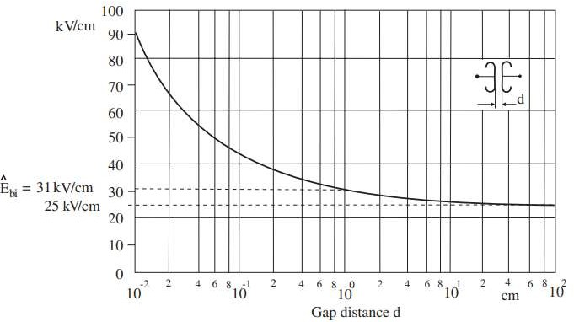
Paschen’s Law
Breakdown voltage characteristic of atmospheric air in uniform fields

Slide 17
Paschen’s Law
It tends to ≈ 24 kV/cm for long gap distances of the order of about 10 cm and greater. The value ≈ 31 kV/cm is applicable only for δd = 1, that is for one cm gap at 760 Torr and 20º C. This is the usually quoted breakdown strength of air at room temperature and at atmospheric pressure.
Thus, the electric strength value 30 kV/cm, measured across one cm gap in uniform field at normal temperature and pressure, is known as the “inherent or intrinsic strength” of air.
For gap distances of a few mm, the electric strength is much higher than 31 kV/cm. It has been measured to be about 92 kV/cm for a gap distance of 0.1 mm.

Slide 18
Penning Effect
Paschen’s law does not hold good for many gaseous mixtures. Typical example is that of mixture of Argon in Neon.
A small percentage of Argon in Neon reduces substantially the dielectric strength of pure Neon. In fact, the dielectric strength is smaller than the dielectric strengths of either pure Neon or Argon.
The lowering of dielectric strength is due to the fact that the lowest excited stage of neon is metastable and its excitation potential (16 eV) is about 0.9 eV greater than the ionization potential of Argon.
The metastable atoms have a long life in neon gas, and on hitting Argon atoms there is a very high probability of ionizing them. This phenomenon is known as Penning effect.

Slide 19
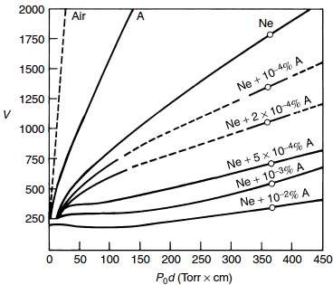
Penning Effect
13.7 V
16.6 V

Slide 20
Process of De-ionization
If the ionization processes lead to the breakdown of gases, de-ionization processes enhance the insulating properties of the gases.
The most common de-ionization processes encountered in gases are:
Recombination
Attachment
Page 20

Slide 21


Process of De-ionization
Recombination is a process by which positive ions combine with electrons to form neutral atoms.
The potential energy and relative kinetic energy of the recombining electron-ion pair is released as quantum of radiation.
In other words, when an electron is captured, it loses kinetic energy with net reduction in the average value of α.
Symbolically, the reaction is represented as:

Slide 22
Process of De-ionization
Attachment is the process in which negative ions are produced by the attachment of an electron to an atom or a molecule.
The reason is that the outermost orbit of an atom of an electronegative gas is just short of one or two electrons. By attaching an electron, the atom becomes a stable negative ion.
Since negative ions like positive ions are relatively heavier as compared to free electrons, and therefore, under the applied field, they do not gain sufficient energy to produce ionization by collisions.
Thus, the attachment represents an effective way of removing electrons which otherwise would have led to current growth and breakdown at low voltages.

Slide 23


Process of De-ionization
The gases in which attachment plays an active role are called electronegative gases such as oxygen, sulphur hexafluoride, freon, carbon dioxide, and fluorocarbons.
Symbolically, the reaction is represented as:
This is the reason that SF₆ gas has excellent insulating strength because of its affinity for electrons (electronegativity). Symbolically,

Slide 24
THANK YOU FOR YOUR ATTENTION

